Slide 1

M1 Mobile international Calling

Slide 2

Hypothesis
Removing free international calling from customers' plans would not have a negative impact on customer loyalty
A small telecommunications company that offers home-based service is looking to cut their international roaming costs by passing some of the expense to the customer
Free international calling is a free service/feature in the current state, but the stakeholders would like to know the potential impact of charging the customer

Slide 3

Hypothesis
Customer usage of international usage is higher for those who do not pay for the premium plan, versus those who do

Slide 4
Key Data
Key Data Points (variables)
State- This data is broken down my market, so I decided to group by state for stakeholders to easily identify their key market areas.
International Plan- The second most important variable for the stakeholders is if the customer already has an existing international plan.
Total Monthly Minutes- Usage variables make great visual indicators, so I included the total domestic minutes data.
Total International Minutes- Including the international calling usage is a great visual indicator for the stakeholders.
Total Domestic Calls- Including the number of independent calls made domestically shows volume or ‘quantity’ versus the qualitative comparison to minutes. Capturing the frequency, the customer is dialing domestically.
Total International Calls- Including the number of independent calls made internationally shows volume or ‘quantity’ versus the qualitative comparison to minutes. Capturing the frequency, the customer is dialing internationally.
Number of Customer Service Calls- The customer service call data gives us the potential for escalation.

Slide 5
Mean, median, mode, tails
The standard deviation serves as a gauge of the data's distribution, while the mean and mode values indicate the central tendency and most frequent values in each column, respectively
Larger tail values imply more skewness, and the tail values indicate how much the data deviates from a normal distribution
In general, statistics offer perceptions into consumer behavior about phone usage, which can be utilized to guide marketing and product development initiatives

Slide 6

PMF of Total International Calls
Compared to all international calls made, there is a high probability that a customer would make 4 to 5 international calls per month

Slide 7
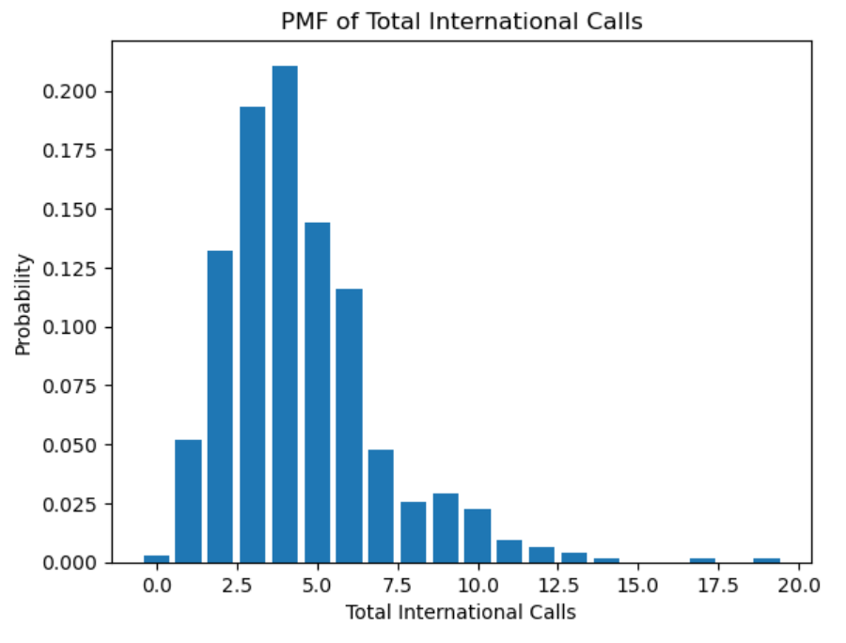

Slide 8

CDF of Total International Minutes
The likelihood of each call being greater than 10 minutes is high
This means if the average customer makes 4 international calls per month of minutes or more, then the total minutes is over an hour as an average
When determining the cost passed on to the customer and customer loyalty, knowing the average usage would be an hour helps determine the potential impact to the customer's bill when the plan is implemented

Slide 9
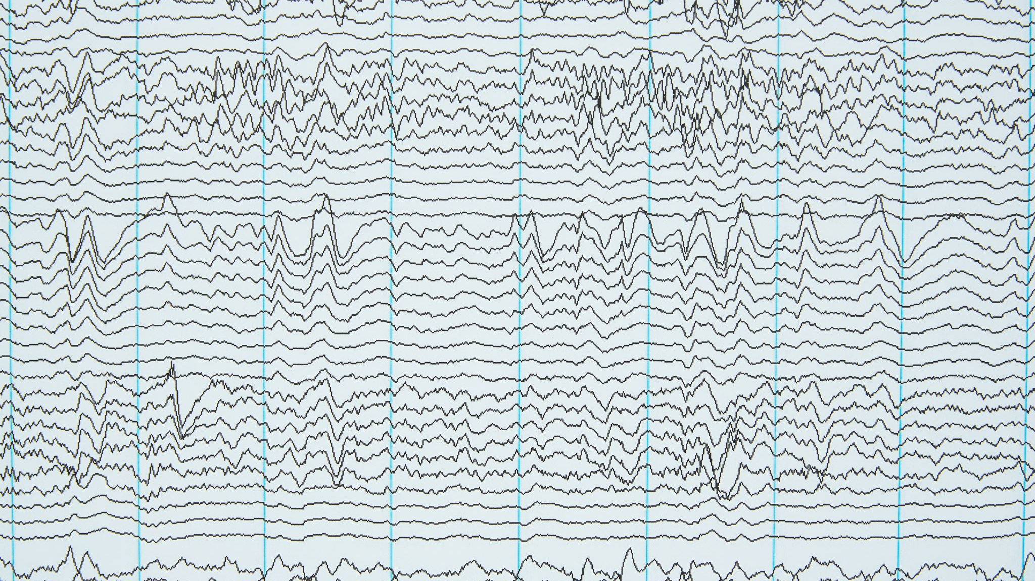
Poisson Distribution with Mean
To further test the strength of the analysis of average number of international calls per month, I modeled the Poisson distribution, which is the probability of the number of calls per month to compare
The result is awfully close to the previous analysis of 4 calls on average per month

Slide 10
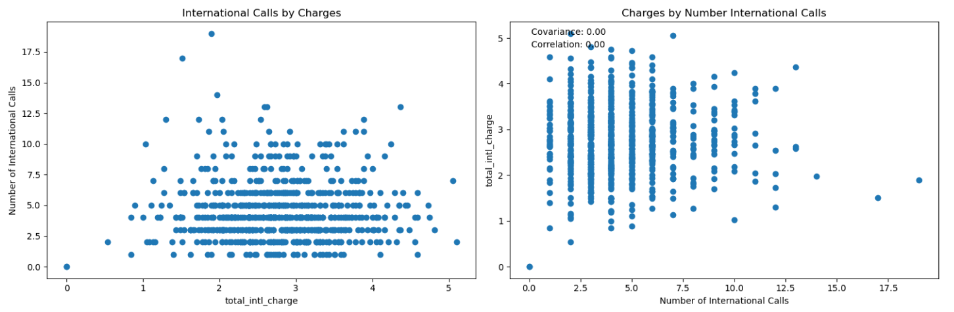
International Charges

Slide 11

Scatter Plot Analysis
Now focusing on the earning potential by number of international calls, we can see that the bulk of international charges are generated between 2.5 and 7.5 calls per month
This tells us that the duration of the call has the greatest impact, versus the number of calls
This is something the stakeholders may want to consider as an easier transition for the customer in charging a ‘connect’ fee instead of by minutes

Slide 12

Hypothesis Testing
The results of the data analysis point to a sizable discrepancy between the mean number of local and international calls
The estimation of the mean difference is quite accurately estimated because the standard error of the difference is 1
The unusually significant t-statistic of 245.18 indicates an exceptionally low likelihood that the variation in means is the result of chance

Slide 13
Regression Testing
According to the regression results and the F-low statistic's p-value, the model is statistically significant
The 'intl to domestic ratio' variable explains only a small percentage of the variation in 'total domestic calls,' as seen by the R-squared value of 0
The coefficient for "intl to domestic ratio" is significant and negative, showing that a rise in the proportion of international calls to domestic calls is accompanied by a fall in the volume of domestic calls

Slide 14
Conclusion
More than 90% of current customers use international calling. This means moving to a subscription model for international calling will impact a large segment of customers.
Consider the average length of call vs average number of international calls per customer.

